Slide 1
Connect Pictometry Online End User
Instructor: Laura Mondo

Slide 2
Training Objectives
Introduce Pictometry
Logging In
Overview of the Interface
Navigating the imagery
GIS Layers and Query Tool
Image Analysis Tools
Annotations and Bookmarks
Saving and Sharing Workspaces
Exporting and Extracting Images
Preferences
Accessing Help

Slide 3
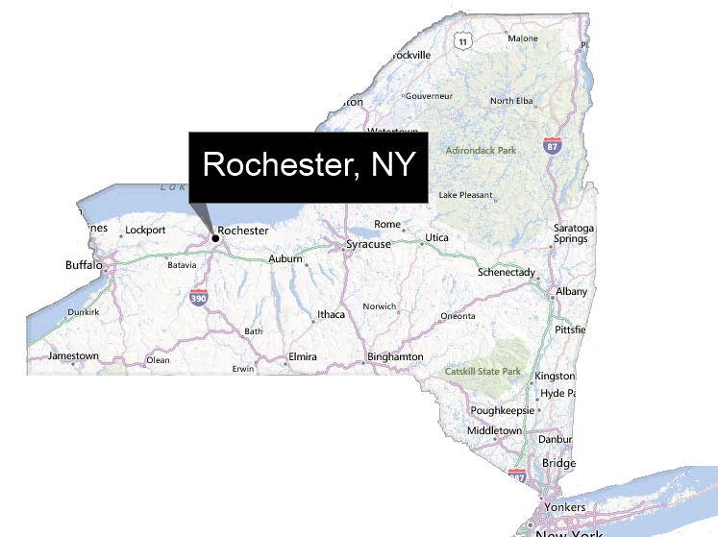
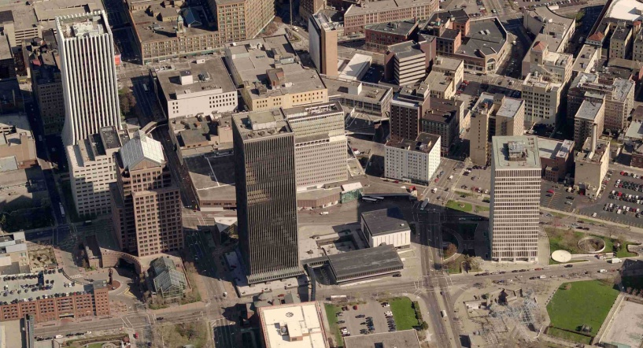
Pictometry
Based in Rochester, New York
Provides:
A Library of Geo-Reference Aerial Imagery
Image Viewing Applications

Slide 4
Supported Browsers
Internet Explorer Mozilla Firefox
Chrome

Slide 5
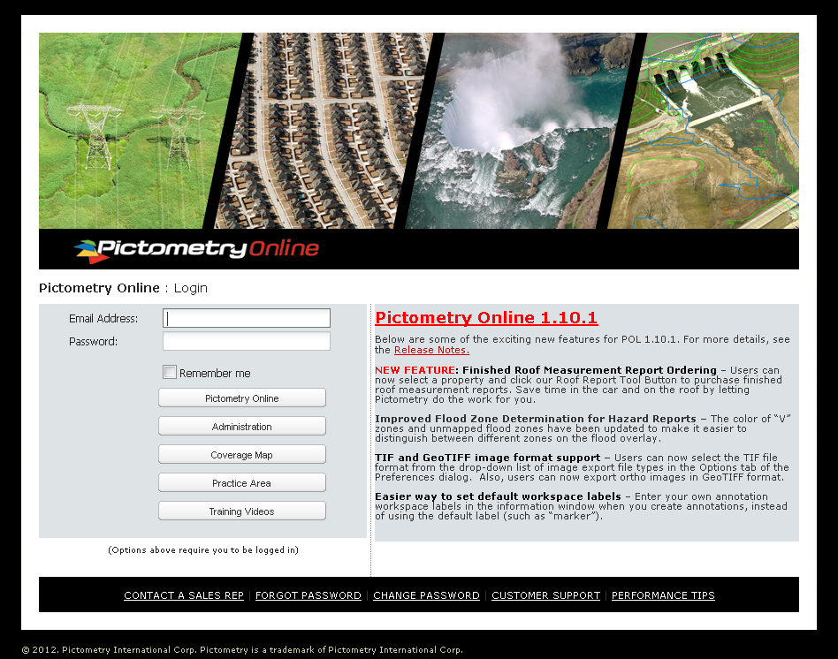
Logging In
https://pol.pictometry.com
Type in email address and password provided by your Administrator
Select Pictometry Online
To change password, select Change Password at bottom of page

Slide 6
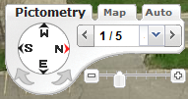
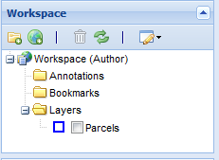
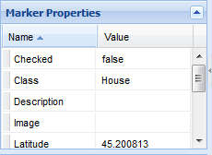
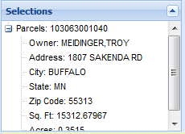
POL Interface
Image Navigator and Basemap
Pan and Image Tools
Measurement Tools
Annotation Tools (full user)
Street Labels, Erase, Measurement Pad
Sidebar Panels:
Workspace Properties Selections

Slide 7
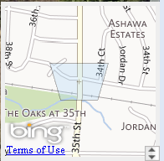
Finding Images
Search Profiles
Address, Parcel ID, Owner Name, etc.
Latitude/Longitude
Image Tool
Use to focus and center on a location
Base Map
In lower right corner

Slide 8
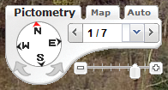
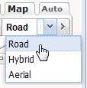
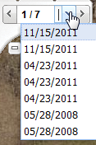
Navigation
Navigator Control Panel
Pan Tool
View Maps, Enable Auto Hybrid & Aerial Pictometry Hosted only
Click oblique compass arrow to rotate...
Access other available images
All years, from the current direction
Zoom Control
Auto switches between Neighborhood and Community at preset 50% zoom level
...or click directional Cameras in Image Window to rotate
View from Ortho, North, South, East, West

Slide 9
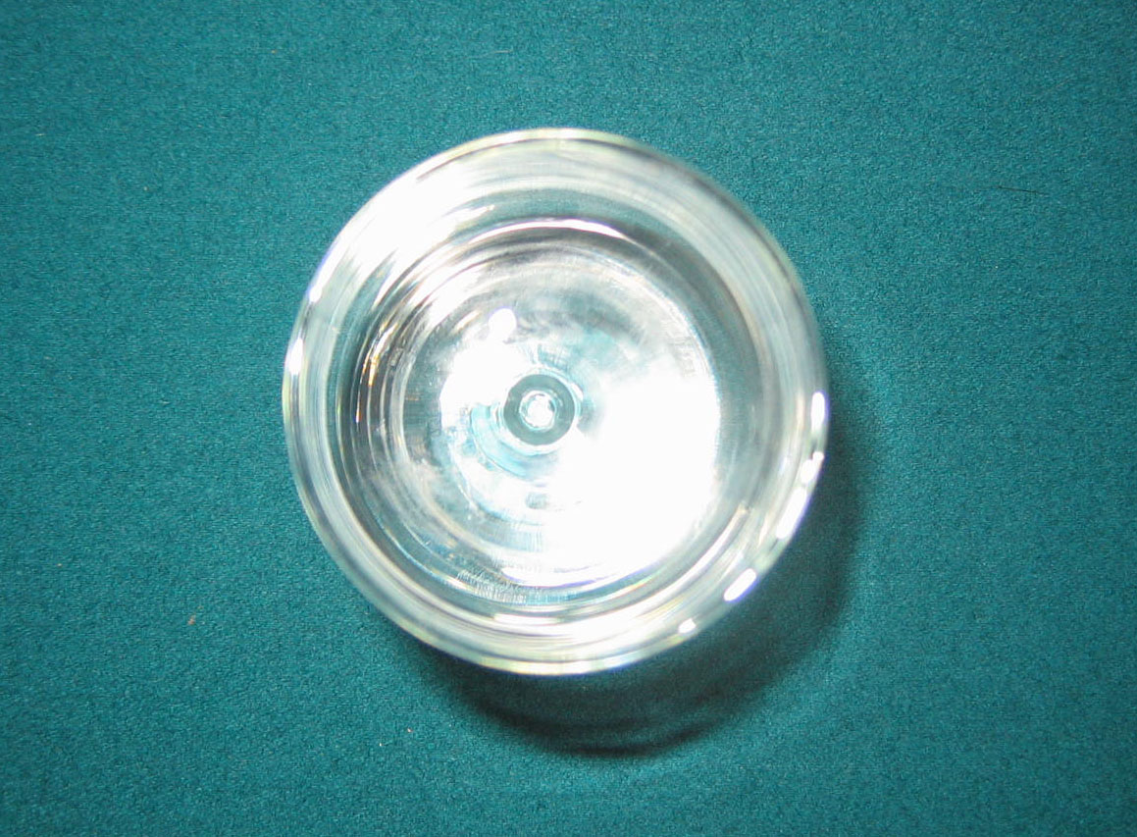

Slide 11
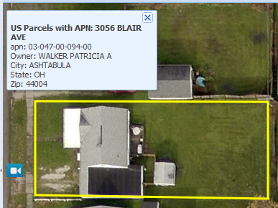
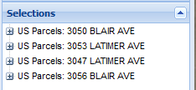
GIS Layers & Query Tool
Check the layer in the workspace
tree to display the layer.
Show streets using the Street Label button.
Use the Query Tool to identify street, address or parcel information.
For best performance, render layers only as needed. A layer can be queried without being displayed.
Click and drag to query multiple objects. Results appear in the Selections panel.

Slide 12
Image Analysis Tools
Distance Tool – Drag to measure, use V key for vertex, ALT key for freeform line
Height Tool – Drag to measure from bottom to top of object
Area Tool – Drag to measure, use V key for vertex, ALT key for freeform line, CTRL key for parallelogram
Elevation Tool – Click on ground to view elevation, use CTRL key to find difference in elevation
Location Tool – Click a location to view Lat/Long coordinates
Bearing Tool – Click and drag to get orientation to True North, Use CTRL key to drag an addition line to measure an angle
Pitch Tool – Measure area and pitch of a roof

Slide 13
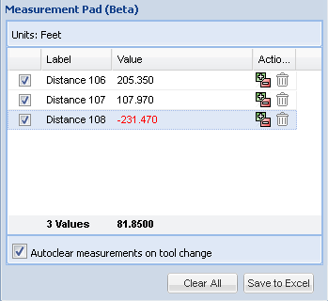
Measurement Pad
Lists and totals measurement results for the current tool you are using
A measurement can be added or subtracted from the total
To save results, export Measurement Pad to Excel

Slide 14
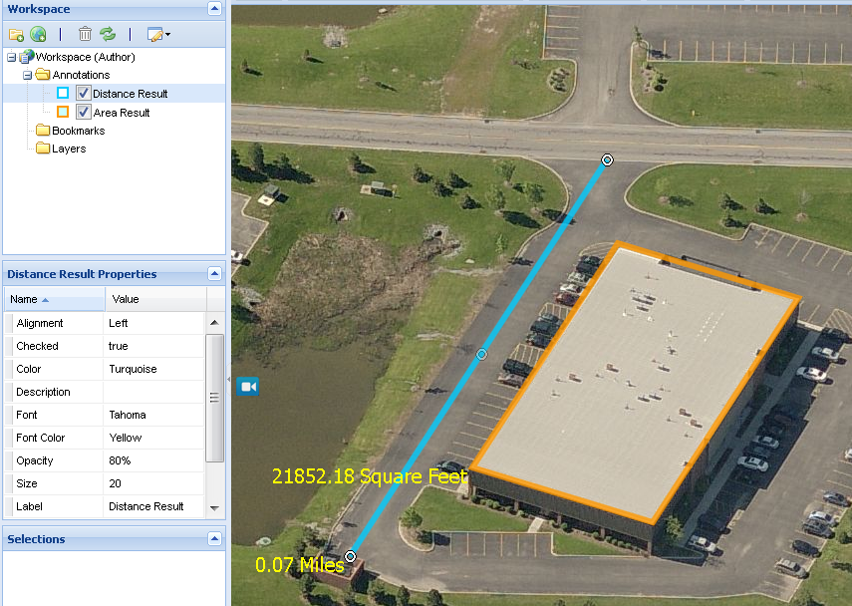
Permanent Annotations
Measurements can be Permanent
After creating your measurement, click the Permanent Annotation button
Permanent Measurements are added to the Workspace as Annotations
Change the properties of any annotation in the Properties panel
Move or resize an annotation using the ‘grab handle.’

Slide 15
Annotations
Marker – Add an icon to the image.
Text – Enter text to display on the image.
Line – Add a line by clicking a starting point and clicking an ending point to create a segment. Double-click to complete the line.
Shape – Click each point to create segments. Double-click to complete the shape.
Circle – Click center point of circle and then click on outer edge of circle (creating a radius).
Can organize Annotations into folders
Rename Annotations for relevancy

Slide 16
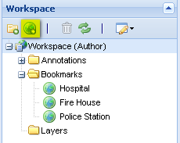
Adding Bookmarks
Bookmark locations within your imagery by selecting the ‘Add Bookmark’ button
Double-click on the bookmark (or select bookmark and hit Enter) to go to the location

Slide 17
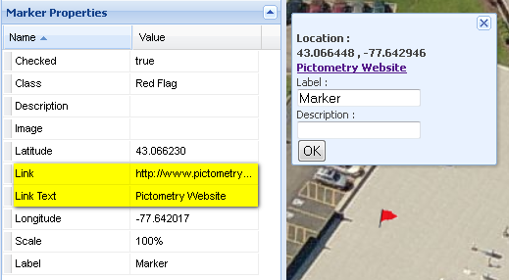
Link a Marker
Use a Marker as a Link
Link to a Web-Site URL
Link to an Image URL
Double-click on the marker in the image window to see the link

Slide 18
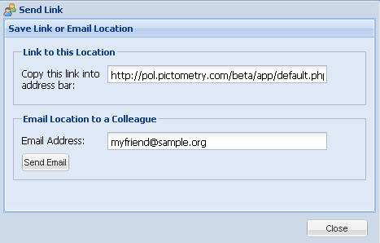
Link Tool
Link Tool
Links another user within the organization, via Email, to an image currently being viewed

Slide 19
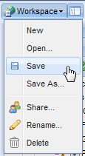
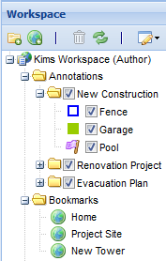
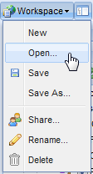
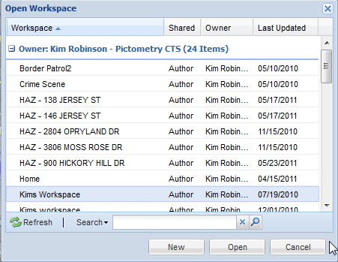
Using Workspaces
Use Workspaces to Save:
Bookmarks
Permanent Measurements
Annotations
Workspace > Open:
Access saved workspaces
Access workspaces others have shared with you.
Preferences can be set to return to the last used workspace upon login.

Slide 20
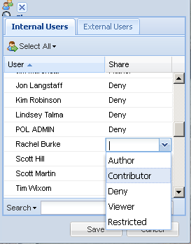
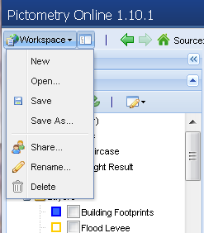
Sharing Workspaces
Workspaces are saved on the server and accessible from any computer via a web browser
Workspaces can be shared with:
Other POL users within the same organization (Internal)
POL users in another organization (External)
Privileges are assigned by the author
By default, all other users are denied access to your workspaces

Slide 21
Workspace Rights
DENY: User is not allowed any access to the workspace.
RESTRICTED: User can view the workspace, but cannot modify or save it.
VIEWER: User can view the workspace and save a copy. The user becomes the ‘Author’ of the saved copy.
CONTRIBUTOR: User can modify and save the workspace. They cannot delete, rename, or share with other users.
AUTHOR: User can modify, save, share, rename and delete the workspace. The user who creates a workspace (or saves a copy) is automatically the Author.
IMPORTANT: Changes may be lost if multiple users modify a workspace at the same time, depending on who saves first. Manage your collaborative projects accordingly.

Slide 22
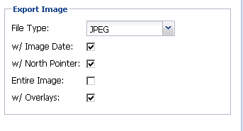
Exporting and Extracting
Set Export Preferences to:
Export Window or Entire Image
Include Overlays
Use Export to export the entire image or image window
Use Extract to select a specific part of the image

Slide 23
Preferences
Preferences can be changed by each user. Changes are ‘sticky’ based on personal login.
Popular preferences:
Options: Enable 25% zoom
Options: Walk the Earth ON/OFF
Advanced: Search Depth = 50
Advanced: Enable Fade Transitions
Units: Location unit preferences
Use the HELP feature to learn more about preferences and tools.

Slide 24
Training Recap
Introduce Pictometry
Logging In
Overview of the Interface
Navigating the imagery
GIS Layers and Query Tool
Image Analysis Tools
Annotations and Bookmarks
Saving and Sharing Workspaces
Exporting and Extracting Images
Preferences
Accessing Help

Slide 25
Getting Help
Go To: http://www.pictometry.com/support
Attend Free Webinar Trainings
Download documentation and videos
Pictometry Online HELP and FEEDBACK
Help and Feedback buttons are available from the POL page
Email: CustomerSupport@pictometry.com
Include screen captures and descriptions
Call: 888-771-9714
Customer Support is available 8:30 - 5:30 Eastern

